Slide 1


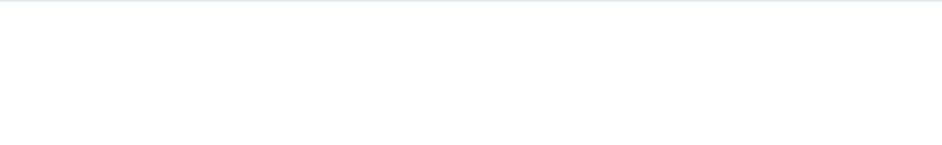
LAN Design: A Simple Case Study
Benazir Bhutto Shaheed University Liyari, Karachi
Using Star and Bus Topologies
Presented by:
Instructor:
Meer Hadeed
Sir Anwar Ali Sathio
Rizwan Ahmed
Course:
Muhammad Abdullah Khan
Computer Networks

Slide 2

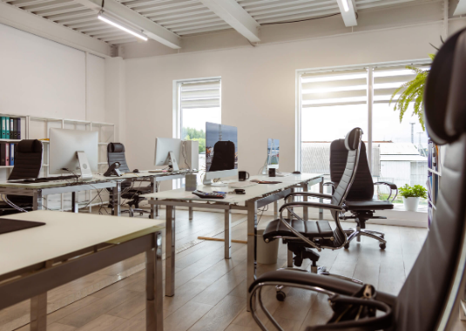
The Challenge: Innovatech's New Office
The Scenario
Innovatech Solutions is moving into a new 2-floor office and needs a reliable, cost-effective Local Area Network (LAN).
—
Company: Innovatech Solutions
—
Floor 1 (Sales): 10 workstations, 1 network printer.
—
Floor 2 (Eng/Admin): 15 workstations, 1 server, 1 printer.
—
Goal: Design a network that connects all devices efficiently.

Slide 3

Core Concept: What is a LAN Topology?
A LAN Topology is the physical or logical arrangement of nodes (like PCs, printers, and servers) on a network.
It defines how devices are connected and how data flows between them. The choice of topology impacts several key factors:
—
Cost
—
Scalability
—
Reliability
—
Ease of Troubleshooting

Slide 4
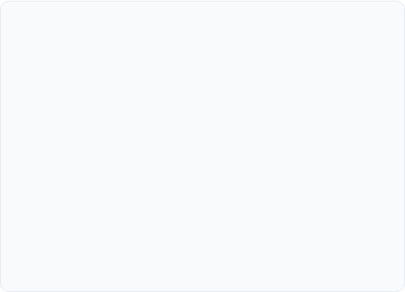
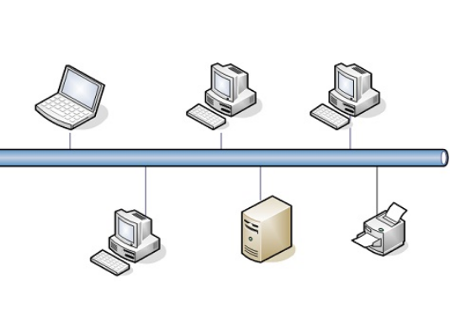
Component 1: The Bus Topology
How It Works
All devices share a single common cable, often called the "backbone" or "bus." Data is sent to all devices, but only the intended recipient accepts it.
Pros:
—
Simple and low-cost to install.
—
Requires less cable than a star.
Cons:
—
Hard to troubleshoot.
—
A break in the main cable takes down the entire network.
—
Performance degrades quickly with high traffic.

Slide 5
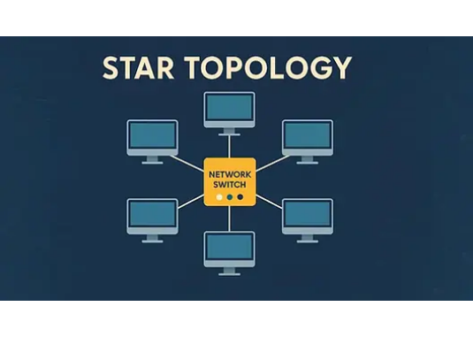
Component 2: The Star Topology
How It Works
All devices (PCs, printers) are connected to a central device, like a switch or a hub. All traffic passes through this central point.
Pros:
—
Reliable: A single cable failure only affects one device.
—
Easy to add or remove new devices.
—
Easy to troubleshoot and find faults.
Cons:
—
Requires more cable (higher cost).
—
The central switch is a single point of failure.

Slide 6
The "Innovatech" Solution
A Hybrid Star-Bus Design

Slide 7
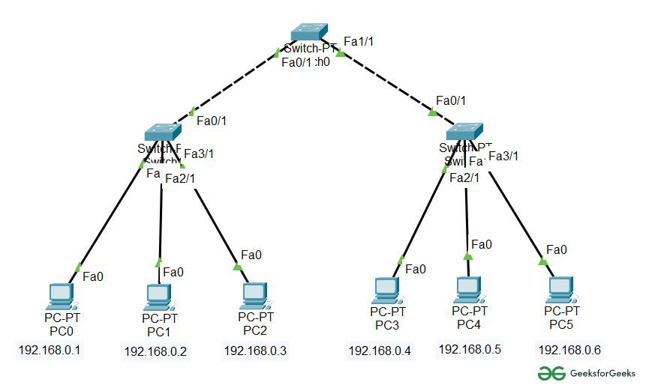
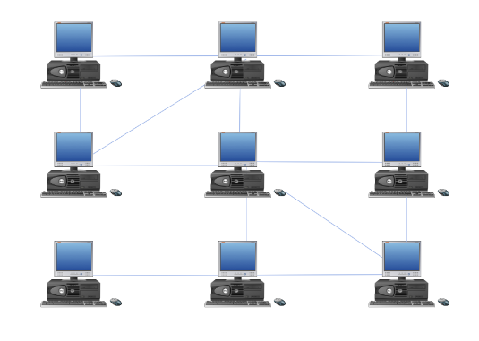
Our Design: The Star-Bus Hybrid
Why a Hybrid?
This design (also called a "Tree Topology") combines the strengths of both systems for our two-floor office.
—
The "Stars": Each floor operates as its own high-performance Star network, connected to a local switch. This isolates traffic and prevents a single PC failure from stopping work on that floor.
—
The "Bus": A simple, vertical "backbone" cable acts as a bus, connecting the two floor switches (Switch A and Switch B) together.
—
Result: Reliable, easy-to-manage, and scalable.

Slide 8
Part 2: The IP Addressing Plan
Organizing the Network

Slide 9
IP Addressing Plan: 192.168.1.0/24
Device / Group | IP Range / Address | Notes
Network ID | 192.168.1.0 | Subnet Mask: 255.255.255.0
Router (Gateway) | 192.168.1.1 | Static IP - Connects to Internet
Server (Floor 2) | 192.168.1.10 | Static IP - For easy access
Printers (Static) | 192.168.1.50 (F1), 192.168.1.51 (F2) | Static IPs - For reliable printing
Floor 1 (Sales) | 192.168.1.100 - 192.168.1.110 | DHCP Pool (11 IPs)
Floor 2 (Eng/Admin) | 192.168.1.150 - 192.168.1.165 | DHCP Pool (16 IPs)

Slide 10
Part 3: Network Security Policy
Protecting the Network

Slide 11
Core Security Policies: A 4-Layer Plan
Physical Security: All servers, switches, and the main router must be in a locked IT closet or server rack.
Device Hardening: Change all default administrator passwords on the router and switches. Keep all device firmware updated.
Access Control: Enable the router's firewall to block unwanted traffic. Enforce a strong password policy for all user workstations and the server.
Future-Proofing (Wireless): When Wi-Fi is added, create a separate, isolated "Guest" network to protect internal resources like the server.

Slide 12
Remarks & Key Takeaways
Reliable Workgroups: The Star topology on each floor ensures that a single PC or cable failure won't stop others from working.
Simple Backbone: The Bus backbone is a simple, low-cost way to connect the two floors.
Organized IP Plan: The IP plan prevents conflicts and reserves static IPs for critical devices (servers, printers).
Secure Foundation: The security policy protects the network through physical, device, and access-level controls.

Slide 13
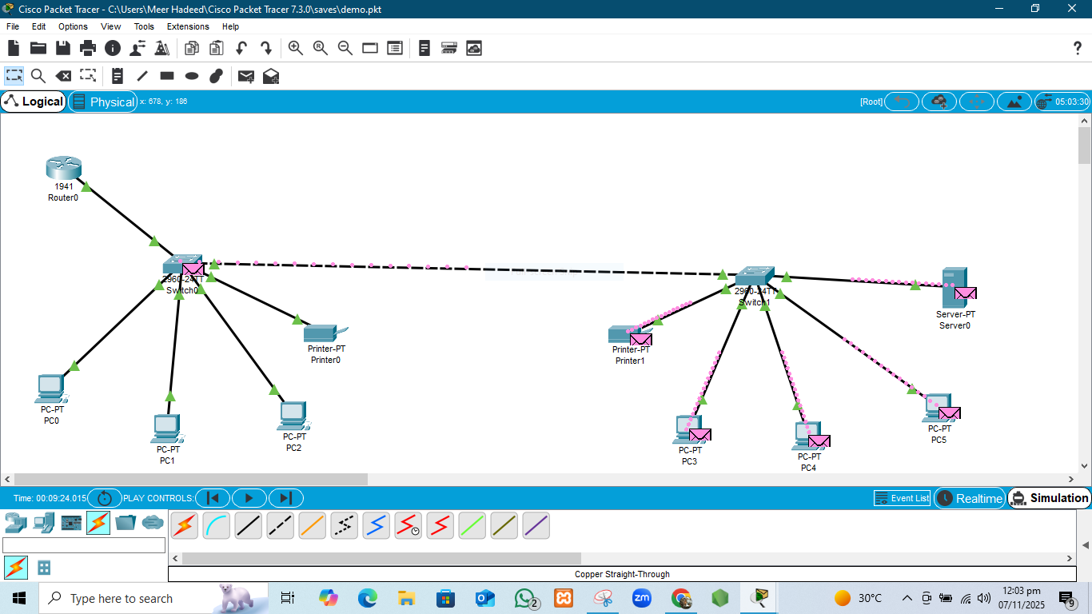

Slide 14
Designed for Growth
A reliable and scalable foundation.

Slide 15
Questions?
Thank You

